Slide 1
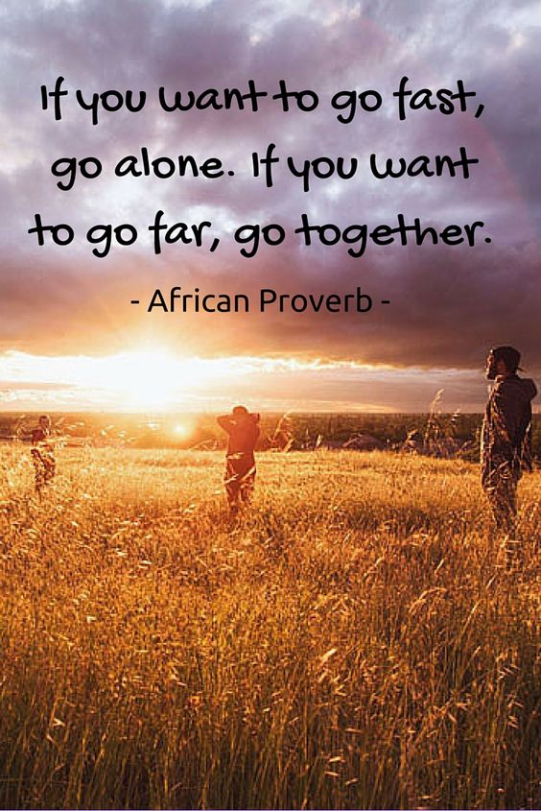

Third sector synergy spark
02.07.2025

Slide 2
Today’s plan
Quick recap on work so far and update on funding
Priority areas for transformational change
Getting into specifics of project planning

Slide 3
Remember Session 1: Collective vision
We believe that the voluntary sector in Angus is a powerful force for good. We all have valuable and unique expertise and perspectives, when we work together we are bigger than the sum of our individual organisations.
Through collaboration we will have stronger relationships with each other and the families we work for. We will make better use of our resources, strengthen the outcomes we work towards, and have better understanding of our shared impact.
Through our relationships, families in Angus will more easily access seamless support in the right place, at the right time.

Slide 4
Session 1: Principles
How we’ll treat each other | How we’ll work together | How we’ll improve together
Trust | Accountability – to ourselves and each other | Learning and growth mindset
Transparency | Efficiency and effectiveness - making the best use of what we have | Commitment to the bigger picture
Mutual respect | Open communication

Slide 5
In the last couple of sessions we’ve worked on…
Mapping of what’s happening across the sector locally where we identified some gaps
Developing our logic model (impact framework)
  A super high-level snapshot because it’s too big for a slide:
For who | How they feel | What they learn and gain | What they do differently
Parents | Confident | Skills | Effectively manage situations
Children | Optimistic | Trust | Engage in school
Education | Supported | Better use of resources | Fewer exclusions
Community orgs | Empowered | Autonomy/choice | Peer advocates/ champions
Social work | Connected | Earlier interventions | Less gatekeeping

Slide 6
Priority family types
Lone parent families
Families which include a disabled adult or child
Larger families
Minority ethnic families
Families with a child under 1
Families where the mother is under 25

Slide 7
Some priority areas – from Angus Council
Support for families with children with additional support needs
Support for families to travel across Angus for health, educational and social needs
Support for families with babies, toddlers and infants
Support for families to access affordable activities for children of all ages
The areas in Angus deemed to be most deprived are:
  Arbroath – the Harbour area, and the Warddykes, Kirkton, and Cliffburn areas
  Brechin East area

Slide 8

Reminder: the WFWB principles
Non-stigmatising
Whole Family
Needs based
Assets and community based
Timely and Sustainable
Promoted
Take account of families’ voice
Collaborative and Seamless
Skilled and supported workforce
Underpinned by Children’s Rights

Slide 9
Ideas from session 5
Angus Independent Advocacy: peer-led family support groups
Barnardo’s: transition support for P6/7 with additional support needs
Aberlour: practical assistance for new mums
Safe Families: community volunteer family support
Relationships Scotland: family mediation for conflict resolution

Slide 10
Some gaps already identified
Fun, informal, community-based activities
Support for fathers
Transitions support for nursery to primary
Enhancement of existing supports
Opportunities for grassroots community groups
Notes:
The group discussions highlighted several areas where additional support or innovation could enhance the overall impact of the programme:
Fun, informal, community-based activities to complement more structured interventions.
Support for fathers, including targeted engagement opportunities.
Transition support for younger children, particularly from nursery to primary school.
Enhancement of existing services, not just new initiatives – particularly where additionality could increase impact.
Opportunities for grassroots community groups to participate and receive support.

Slide 11
One you (hopefully!) prepared earlier
What might a grant at various levels (e.g. £5k, £25k, £50k) allow your organisation to deliver?
Who would it support?
What difference would it make?
Would your organisation likely apply individually, or would a collaborative approach be more suitable?

Slide 12
Next steps for grant process
Grant applications open on Monday 7th July, closes 22nd August
VAA £100k per tranche, max £25k per application
AC £200k per tranche, max £50k per application (additional £20k available for start up costs)
 | April 2025 | October 2025 | April 2026 | October 2026
VAA small grant funding | 100k | 100k | 100k | Underspend
Angus Council larger grant funding | 200k | 200k | 200k | Underspend

