Slide 1

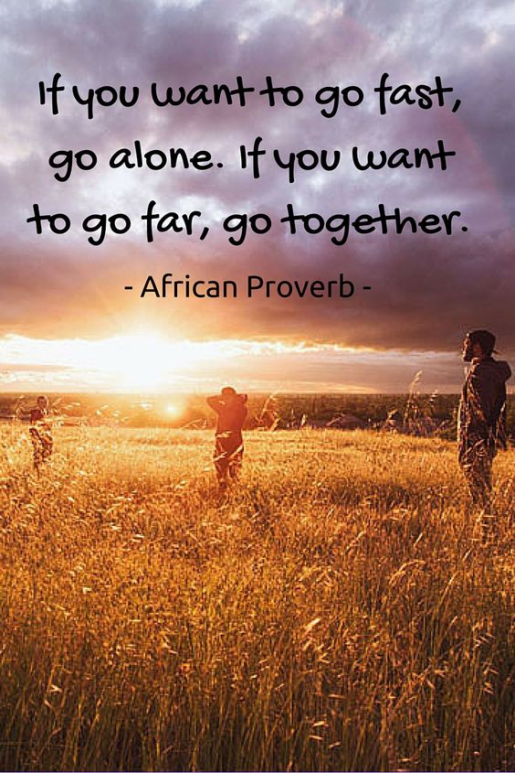
Third Sector Synergy Spark
Session 2 10.03.25

Slide 2
Recap: rough project plan
Session 1
Introductions
Session 2
Introductions and reflections from session 1
Session 3
Planning
Scene setting
Vision
Collaboration principles
Mapping – what’s happening, working, not working, missing
What would success look like
Strengths and opportunities – what’s needed and who’s best placed to do it
How projects could develop over time
Sustainability
Monitoring
Introductions and reflections from session 2

Slide 3
Session 1 recap: Collective vision
Collective vision:
We believe that the voluntary sector in Angus is a powerful force for good. We all have valuable and unique expertise and perspectives, when we work together we are bigger than the sum of our individual organisations.
Through collaboration we will have stronger relationships with each other and the families we work for. We will make better use of our resources, strengthen the outcomes we work towards, and have better understanding of our shared impact.
Through our relationships, families in Angus will more easily access seamless support in the right place, at the right time.

Slide 4
Session 1 recap: Principles
A very large list!! Thematically:
How we’ll treat each other | How we’ll work together | How we’ll improve together
Trust | Accountability – to ourselves and each other | Learning and growth mindset
Transparency | Efficiency and effectiveness - making the best use of what we have | Commitment to the bigger picture
Mutual respect | Open communication

Slide 5
Session 1 recap: High level mapping
What’s happening | What’s working
Social/support/activity groups Workshops and training Advocacy Family support, contact centres, mentoring Mediation, counselling, therapeutic support Employability | Partnerships/relationships across sector Strong relationships with communities Willingness to work differently
What’s not working | What’s missing
Macro – benefits, justice, legal aid, short-term funding Lack of lived experience voice/consultation fatigue Lack of deep understanding of orgs, sector, and community need Attitudes towards sector, and in particular towards early intervention | Earlier intervention services, signposting Face to face contact/walk-in services Social/activity groups in certain areas/for specific groups Support for complex needs, Autism, school refusal families Legal aid, resources, support with court Joint referral pathways, joined-up support across projects

Slide 6
What would success look like?
What might get in the way of us working collaboratively – and how do we fix it?
Are there difficult questions or elephants in the room – and how do we get past them?
How do you respond when alternative ideas are suggested – and how do we create space to explore these fully?
How will we know the collaborative approach is working?

Slide 7
Strengths and opportunities
What’s missing?
Earlier intervention services, signposting
Support for complex needs, Autism, school refusal families
Legal aid, resources, support with court
Face to face contact/walk-in services
Social/activity groups in certain areas/for specific groups
Are there any areas you feel you have strengths in and would like to explore?
In small groups discuss:
What your early ideas are (and it’s ok if they’re vague at the moment!)
What evidence there is for the need
What difference you think it could make, and what’s transformational about it
How it could work alongside other supports or services

Slide 8
Next time…
User journey mapping to understand available supports
Identifying gaps
Planning and next steps

