Slide 1

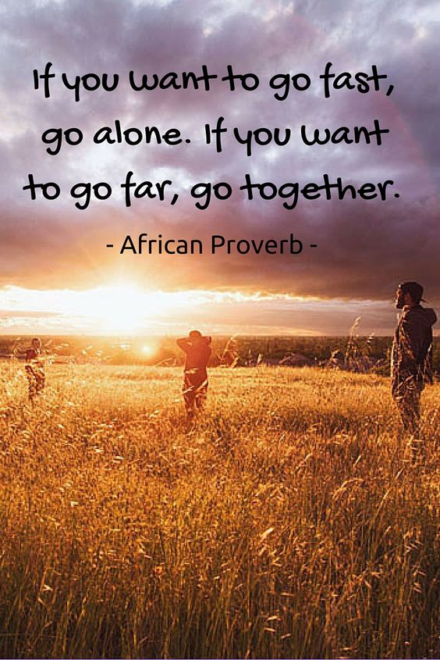
Third Sector Synergy Spark
Session 1 17.02.25

Slide 2
Plan for today
Introducing ourselves and the project
Setting a shared vision for collaboration
Understanding the landscape

Slide 3
A quick recap: About this project
A collaborative approach to transformational change
Reframing potentially damaging competitive processes
Avoiding duplication and encouraging joint working
Working together to identify:
What the greatest needs are
What the biggest strengths are
The best way to embed true transformational change
Leading to funding bids to VAA and Angus Council

Slide 4
Quick recap 2: What it’ll look like
What you’ll bring
Knowledge and insight about supporting families in Angus
Willingness to apply for and deliver WFB projects
What we’ll bring
Facilitation to set a collective vision
What happens with it all
Individual organisations submit bids for work based on the collective vision
Mapping and sharing understanding
Sharing the learning for the approach

Slide 5
Rough project plan
Session 1
Introductions
Session 2
Introductions and reflections from session 1
Session 3
Planning
Scene setting
Vision
Collaboration principles
Mapping – what’s happening, working, not working, missing
What would success look like
Strengths and opportunities – what’s needed and who’s best placed to do it
How projects could develop over time
Sustainability
Monitoring
Introductions and reflections from session 2

Slide 6
Setting a shared vision
Why do you want to work collaboratively?
What’s the difference you want to make?
What would better look like?
Notes:
Small group discussion and feeding back

Slide 7
Some principles for collaboration
Trust
Transparency
Honesty
Commitment to the bigger picture
…anything else? What’s important to you?
Notes:
Short group discussion on what’s important to you

Slide 8
Understanding the landscape
What’s happening? | What’s working?
What’s not working? | What’s missing?
Notes:
4 colour post its

Slide 9
The top three themes from the survey: what would good look like in these areas?
Mental Health and Wellbeing Support:
Mental health support for families, young people, and individuals with specific need
Access to counselling, early intervention, and trauma-informed services
Addressing social isolation and its impact on mental health
Financial and Practical Support:
Financial assistance for food, energy, travel, and living costs
Support for employment and addressing poverty
Access to resources and equipment for those in need
Inclusive and Holistic Community Support:
Inclusive opportunities for all, including those with disabilities
Community connections and support to reduce isolation
Holistic, person-centred support that includes physical, emotional, and social aspects
Notes:
Conversation café type discussion – what would good look like?

Slide 10
Next steps
Our idea:
A session to look in more depth into strengths and opportunities
Map out potential projects and the relationships between them
What would you like to happen next?

