Slide 1


Angus Whole Family Wellbeing
Third Sector SynergySpark: Igniting Collaborative Futures
Question and Answer session 13.02.25

Slide 2

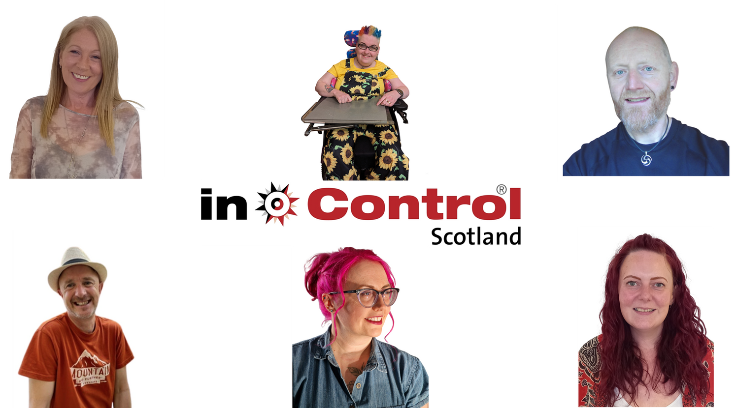
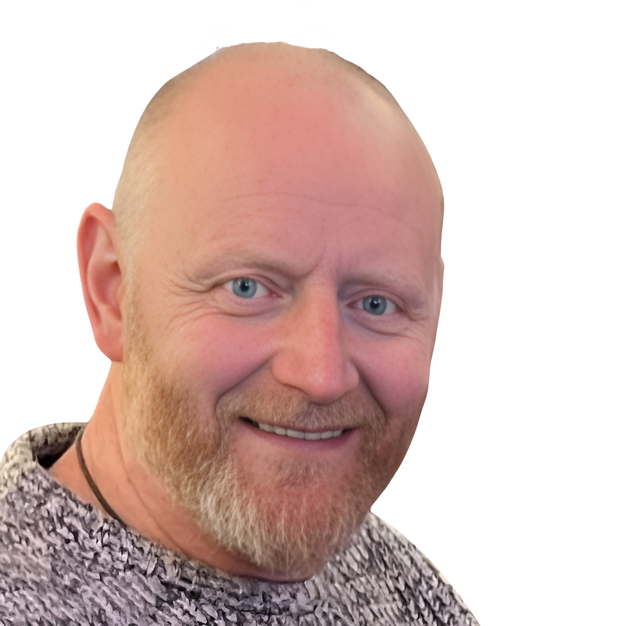

Slide 3
Scottish Government’s Vision for Whole Family Wellbeing
“The vision is for family support to be readily available to families that need it. We want to make sure that families are able to access the help they need, where and when they need it. This will enable us to create a Scotland where more children will only know care, compassion and love, and not a ‘care system’.”
Holistic and early intervention
Reduce the chances of family breakdown

Slide 4
About the fund
Small grant funding administered by VAA
Larger grant funding administered by Angus Council
Tender for an Enhanced Support service

Slide 5
About this project
A collaborative approach to transformational change
Reframing potentially damaging competitive processes
Avoiding duplication and encouraging joint working
Working together to identify:
What the greatest needs are
What the biggest strengths are
The best way to embed true transformational change

Slide 6
What it’ll look like
What you’ll bring
Knowledge and insight about supporting families in Angus
Willingness to apply for and deliver WFB projects
What we’ll bring
Facilitation to set a collective vision
What happens with it all
Individual organisations submit bids for work based on the collective vision
Mapping and sharing understanding
Sharing the learning for the approach

Slide 7
Indicative timeline
Workshops with us:
First session 17th February
Whole Family Wellbeing Angus portal on VAA website in March
Funding and tender opportunities advertised 1st April

Slide 8
Questions?
pauline.l@in-controlscotland.org.uk
alastair.m@in-controlscotland.org.uk
hayley@voluntaryactionangus.org.uk

